Slide 1
Initial Setup Lab-session 0
Computer Vision and Image Processing
Prof: Luigi di Stefano - luigi.distefano@unibo.it Tutors: Pierluigi Zama Ramirez - pierluigi.zama@unibo.it Riccardo Spezialetti – riccardo.spezialetti@unibo.it

Slide 2
Working on your computer

Slide 3
Requirements
These slides will teach you how to configure and install the required libraries in your computer. Requirements:
Windows or Linux-Ubuntu (macOS and other Linux distributions are not in this guide but they should work too.)
Internet connection
We will install:
Python 3.5.x
Pip
Python-Libraries: OpenCV, Matplotlib, Numpy
Jupyter Notebook

Slide 4
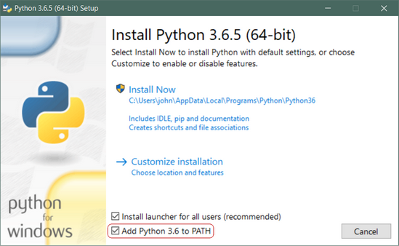
Step 1: Installing Python 3.5.x
Two main versions of Python: Python 2.x and Python 3.x are available.
The two version have several features in common, but they are not fully compatible: a Python 2.x program may not work in Python 3.x and vice versa.
Installing on Windows:
Download the Python3.5.x release from: https://www.python.org/downloads/
Run the installer. Remind to Add Python to PATH
Installing on Ubuntu:
Ubuntu already comes with Python installed. If you want to update it to the latest version open your terminal and run:
sudo apt-get install –upgrade python3
IMPORTANT: After python 3.7.x, OpenCV is only available on Pip in version > 3.4.8.x. Thus, you need to install previous version of python (<= 3.7.x) to run the notebooks.

Slide 5
Step 2: Installing pip
-p /usr/bin/python2.7
PIP is a recursive acronym that stands for “PIP Installs Packages”. It’s a command-line utility that allows you to install, reinstall, or uninstall Python packages with a simple command: pip
Installing on Windows:
Download the get-pip.py installer script from here: https://bootstrap.pypa.io/get-pip.py Right-click on the link and select Save As and save it to any location.
Open the Command Prompt (better Windows PowerShell) and navigate to the folder containing the get-pip.py file (cd path_to_folder).
Run the following command: python get-pip.py
Installing on Ubuntu:
Open your terminal and run the following:
sudo apt-get install python3-pip
[Optional] Virtual Environment if having conflicts with system libraries:
1- Install virtual-env:
sudo pip3 install virtualenv
2 - Create virtual environment:
virtualenv -p /usr/bin/python3
“name-for-your-virtual-environment”
3-Activate it (every new terminal):
source “path-to-your-virtual-environment/bin/activate”

Slide 6
Step 3: Install Python Libraries with pip
Installing on every OS:
Open your terminal (Windows PowerShell for Windows) and run the following commands:
Install numpy (For array operations) :
pip3 install numpy
Install matplotlib (For plotting and visualization)
pip3 install matplotlib
Install OpenCV (Computer Vision Library):
pip3 install opencv-python==3.4.2.16
pip3 install opencv-contrib-python == 3.4.2.16

Slide 7
Step 4: Install and run Jupyter Notebook
The Jupyter Notebook is an open-source web application that allows you to create and share documents that contain live code, equations, visualizations and narrative text. It is useful to explain how to code and to visualize interactively the results of an algorithm or code.
Installing on every OS:
Open your terminal and run:
pip3 install jupyter

Slide 8
Working on Lab Computer

Slide 9
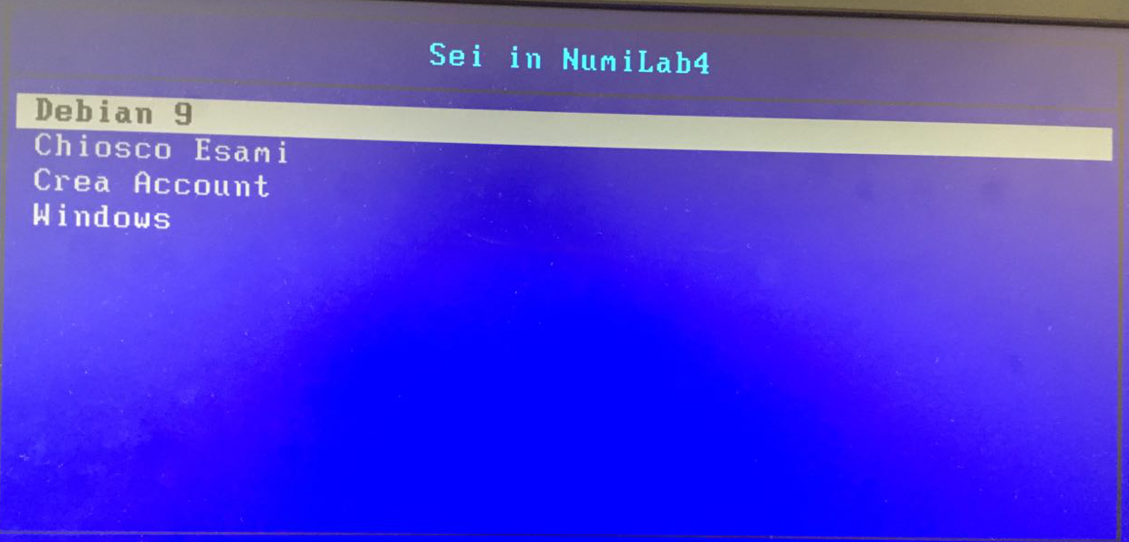
Working on Lab computer
All the packages you need are already installed. If it is your first time in lab, perform the following steps:
Create your account
Login into Debian 9 (only Linux will be supported in lab PCs) with username and password
run startx in the terminal to run the GUI

Slide 10
After Initial Setup

Slide 11
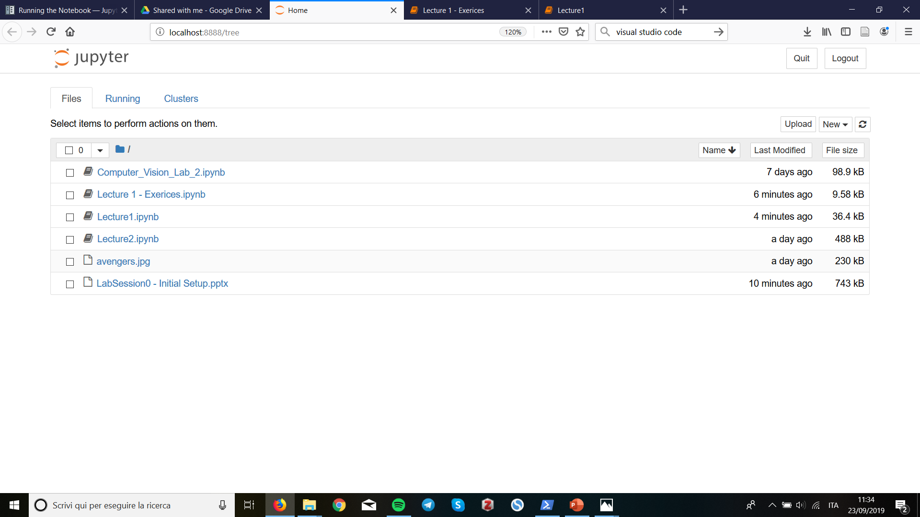
Jupyter Notebook: An overview
Run Jupyter Notebook:
Navigate to the folder containing the lab-session notebooks and launch the notebook server in a terminal (do not close it!) with the following command:
jupyter notebook --ip 127.0.0.1
You should see the notebook open in your browser. If this is not the case, just point your browser to the URL printed on the terminal (default: http://localhost:8888)
Notebook dashboard. Navigate to your notebook (.ipynb file) and open it

Slide 12
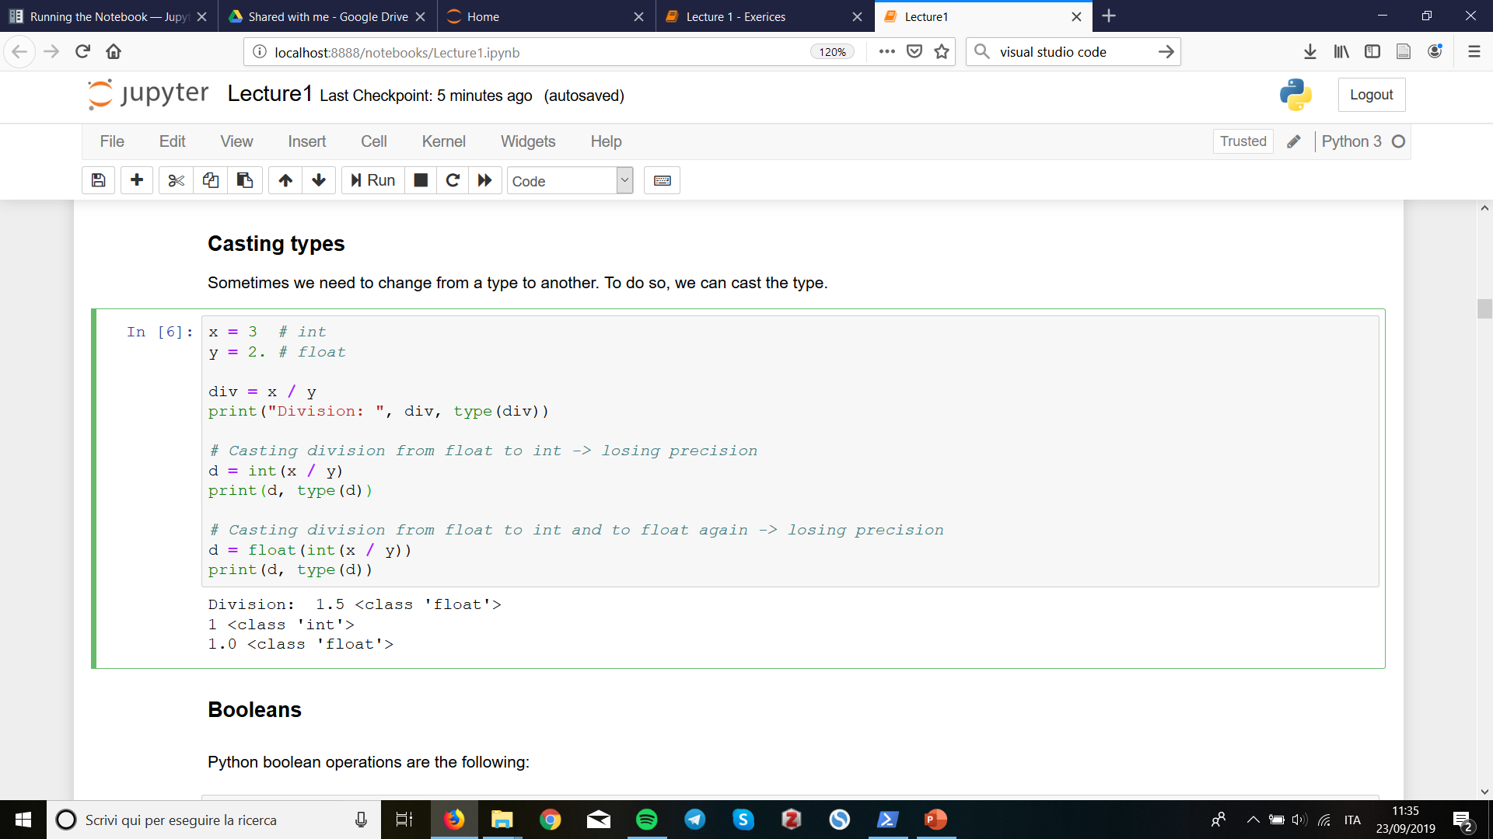
Jupyter Notebook: An overview
Run single code instruction and see the result interactively!

Slide 13
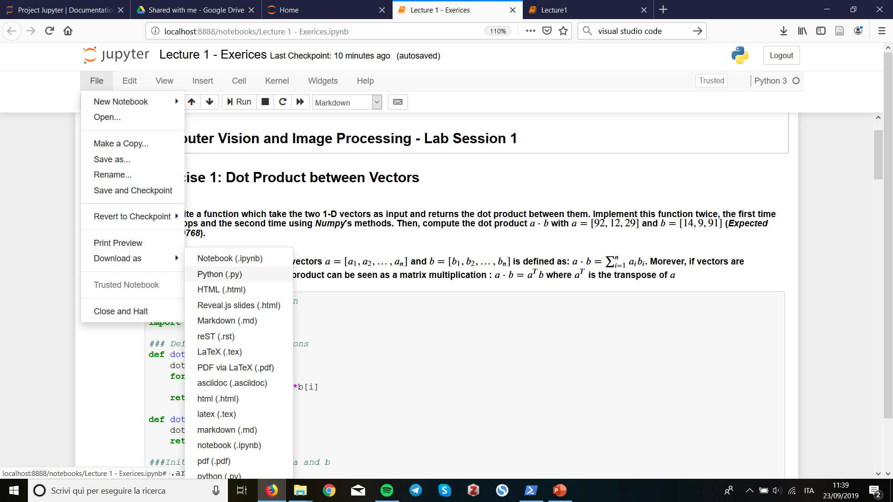
Export python .py from notebook file
You can download all the code cells of a notebook as a single .py file. After that, you can run it as a standard Pyhton script.

Slide 14
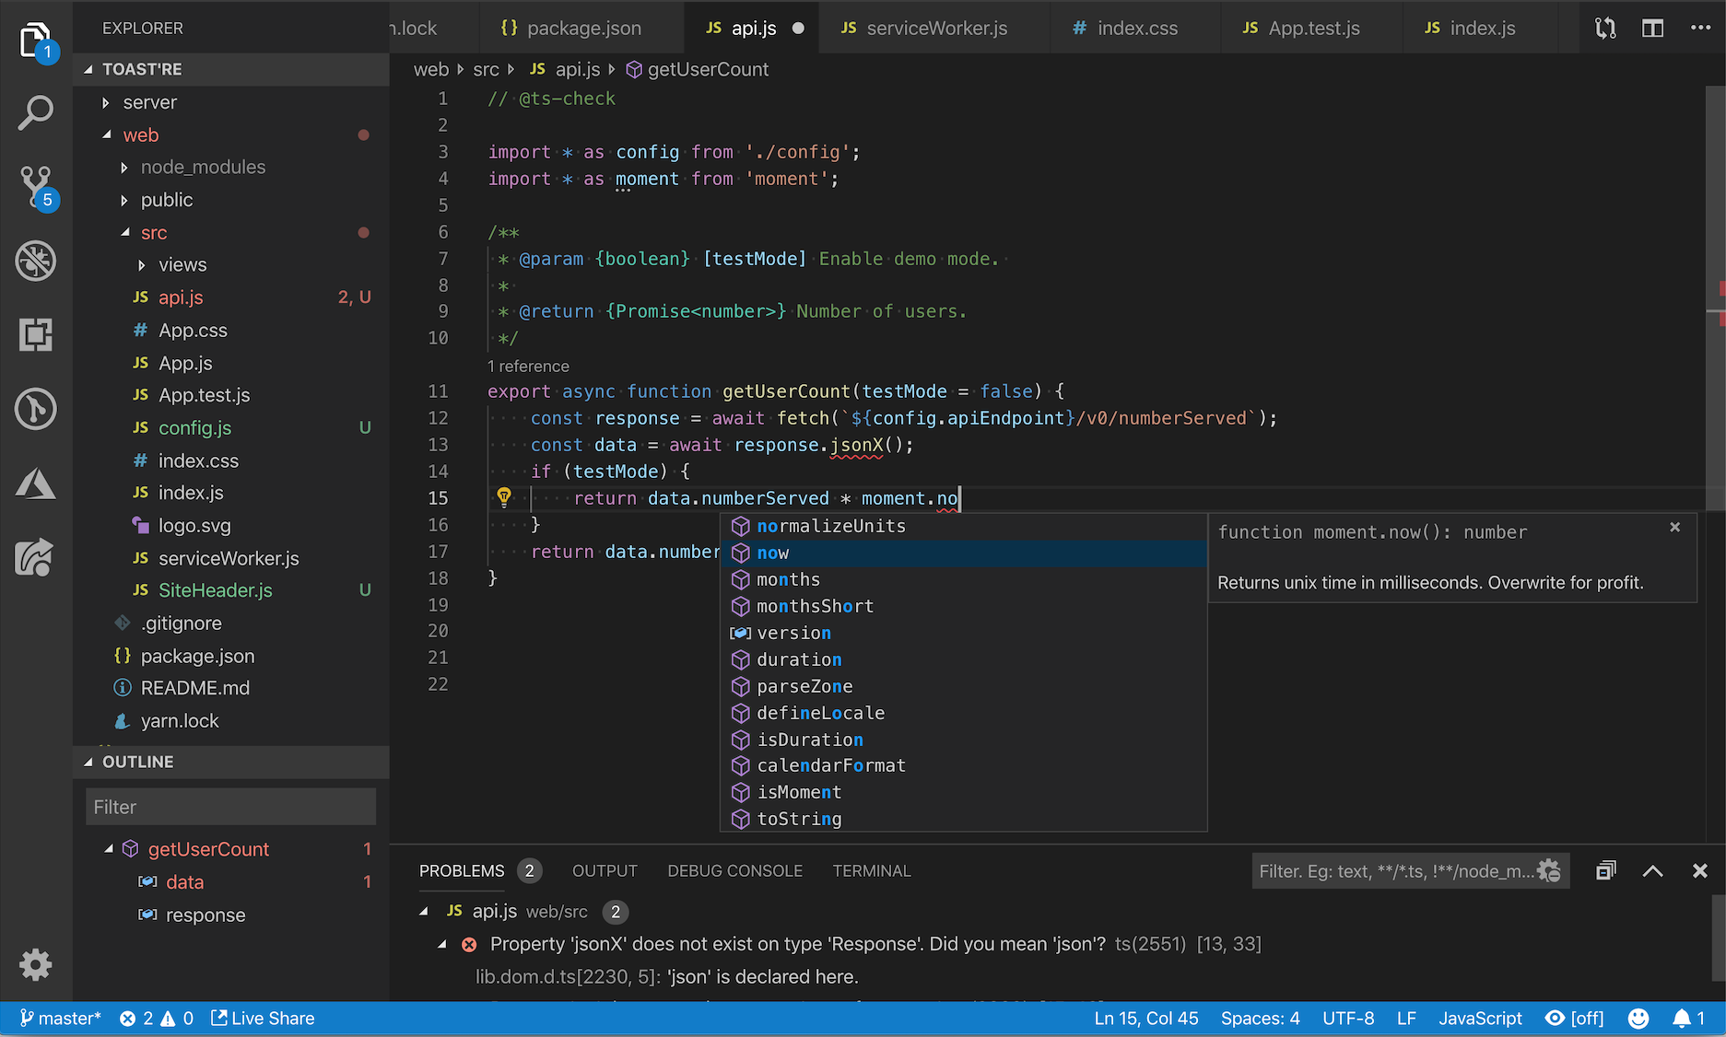
Working from home: IDE and terminal
When you work with python you typically do not program directly on Jupyter Notebook but it is common to use a Source Code Editor such as
Visual Studio Code: https://code.visualstudio.com/
or Pycharm:
https://www.jetbrains.com/pycharm/
Visual Studio Code
When you finish writing your script, navigate in your terminal to your script folder and run:
python my_script.py

Slide 15
References
Python3 documentation:
https://docs.python.org/3/c-api/index.html
Jupyter documentation:
https://jupyter.readthedocs.io/en/latest/
Numpy documentation:
https://docs.scipy.org/doc/numpy/reference/index.html
Matplotlib documentation:
https://matplotlib.org/3.1.1/api/index.html
OpenCV documentation:
https://docs.opencv.org/trunk/d6/d00/tutorial_py_root.html

